Slide 1
High Demand UBER Areas
Presentation Demo
Course: Cloud Computing
Sepideh Berangi(S3793021)
Mohammad Farshidmehr(S3308107)

Slide 2
High Demand UBER Areas
With our mobile app, the clients will be able to access their current location information or any specific part of the map, and it will display the demand rate of user requests based on the data provided by UBER. This information could be useful for UBER to identify the location of busy areas, for profiting more in their business. In addition, this data will be useful for the local government's traffic governance and the police to check the traffic flow of certain areas in order to improve their services.

Slide 3
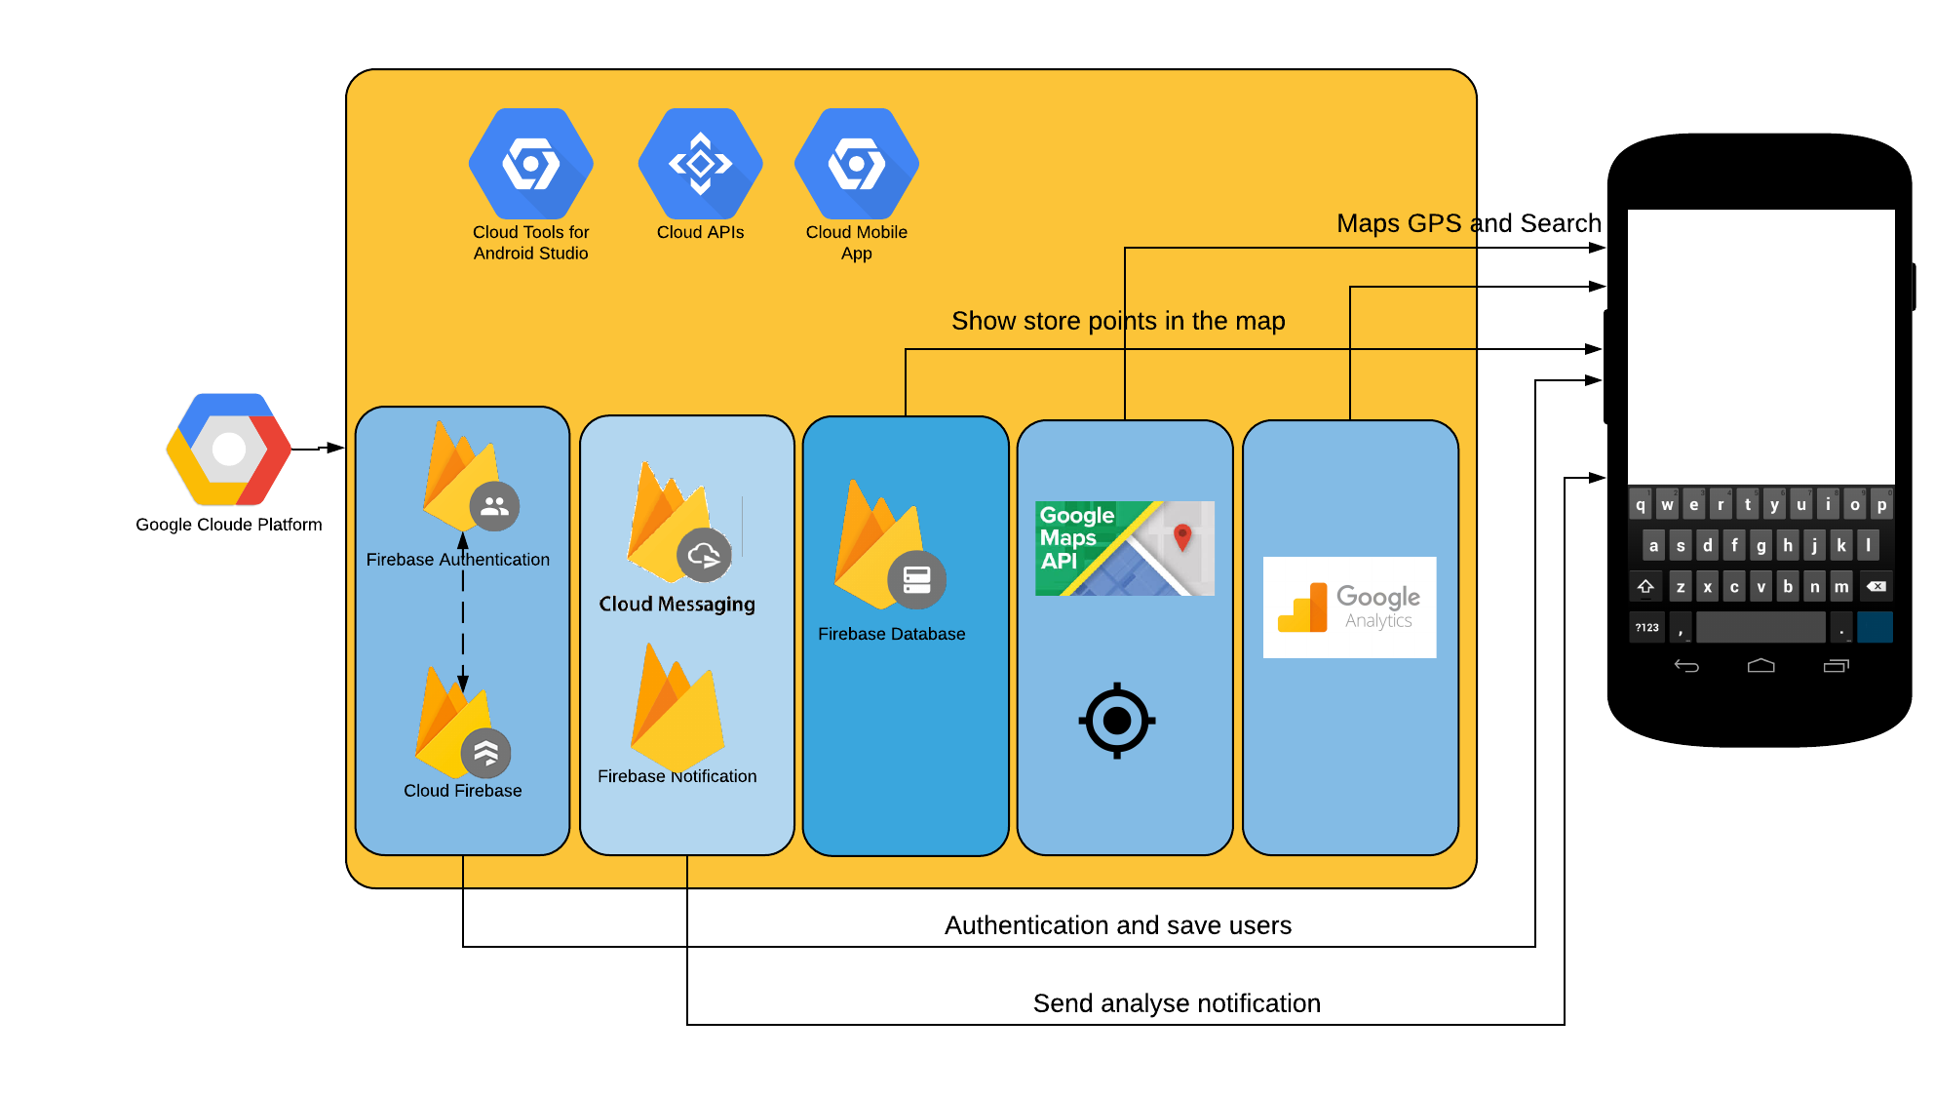
High Demand UBER Areas (Android)

Slide 4
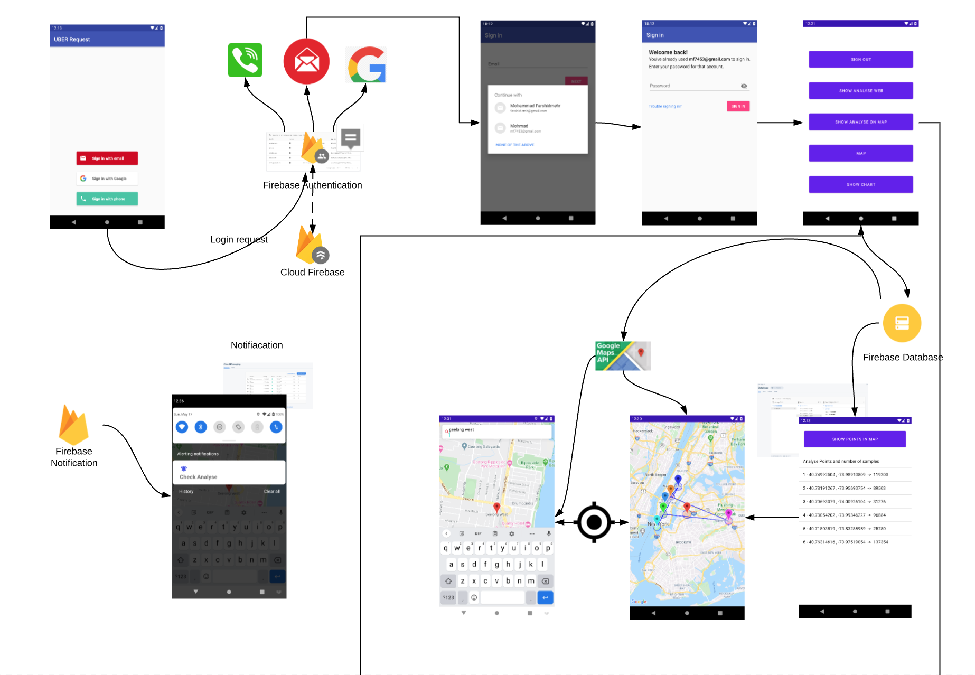
High Demand UBER Areas (Interface)

Slide 5
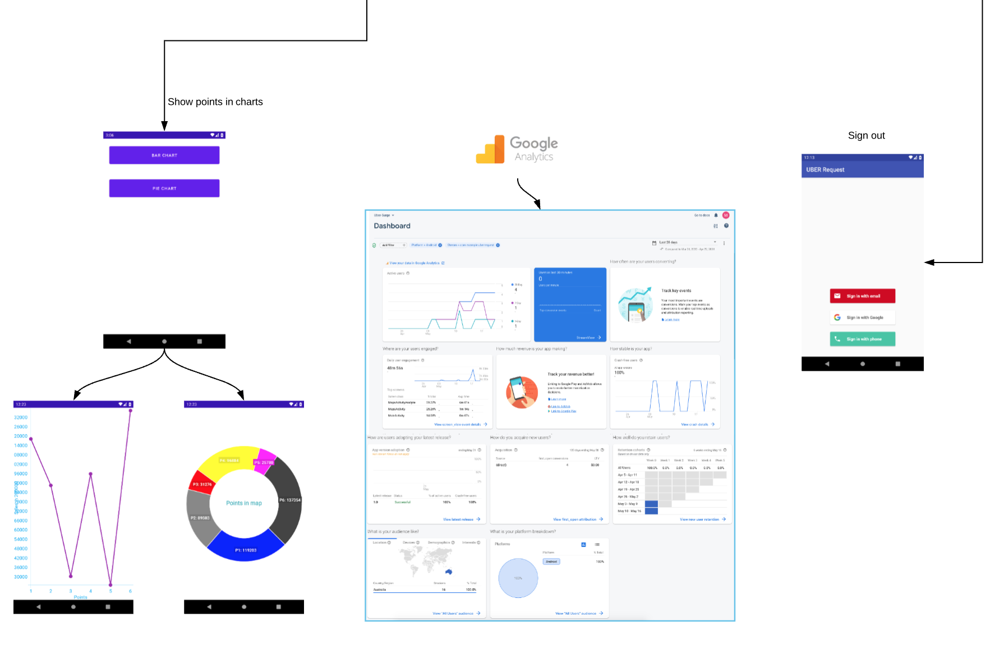
High Demand UBER Areas (Interface) Cont.

Slide 6
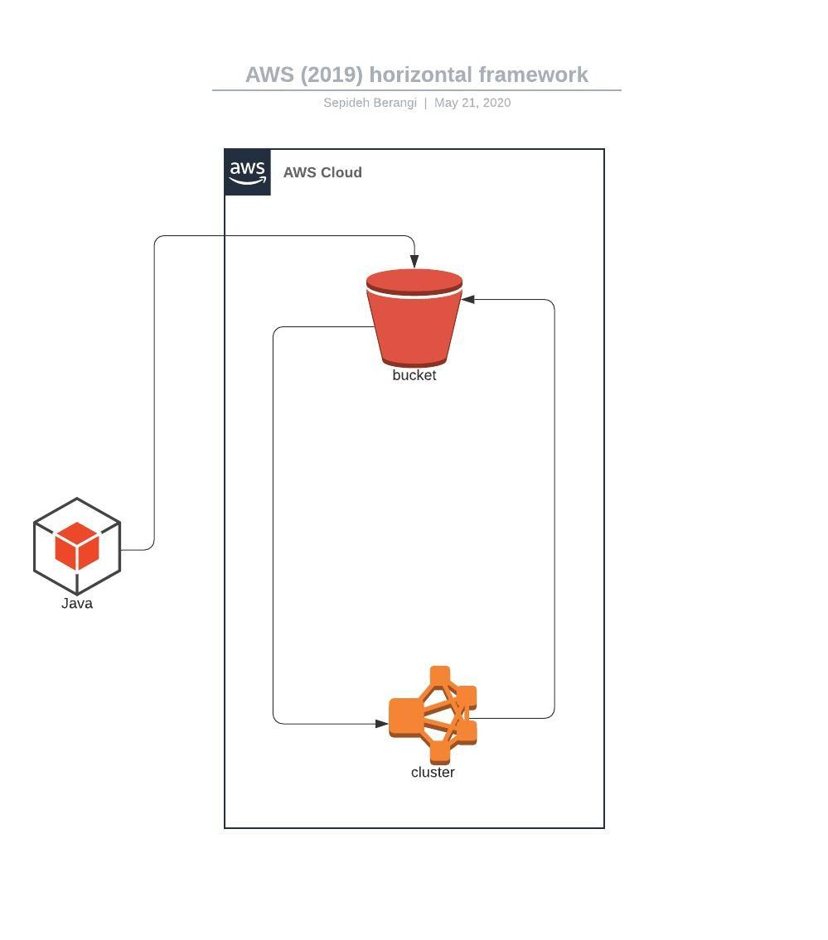
High Demand UBER Areas (AWS)

Slide 7
High Demand UBER Areas (AWS)
K-Means MapReduce
The K-means algorithm to be able to process our large scale data in order to identify the high-demand areas.
1GB the original dataset was about which we reduced it to 22MBs
6 centroids at the beginning of the task
Reads a our from our s3 bucket and initiates the centroids with values, close to the real data point written into a file named ”output.txt” in the output folder of our s3 bucket with the EMR and the s3 bucket
Notes:
http://moore.vn/Uploads/files/2015/3/Moore-Vietnam-Digital-Landscape-2015.pdf
http://access.opennet.net/wp-content/uploads/2011/12/accesscontested-vietnam.pdf

Slide 8
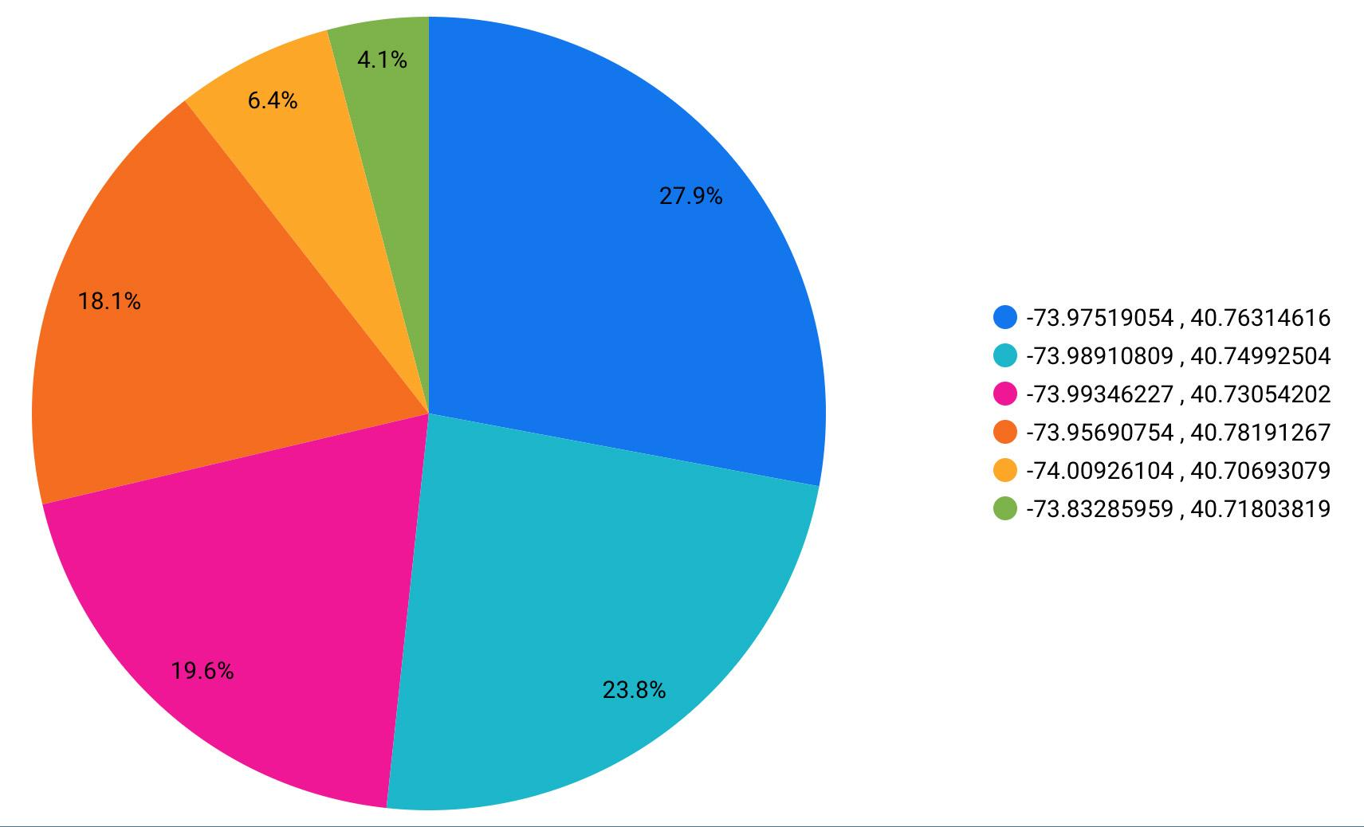
High Demand UBER Areas (AWS)
Notes:
Media support Gov.

Slide 9
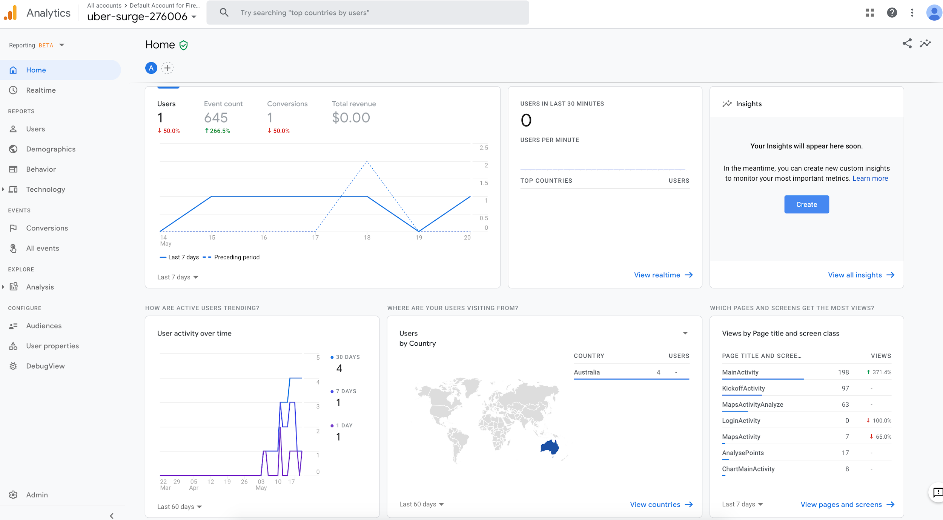

Slide 10
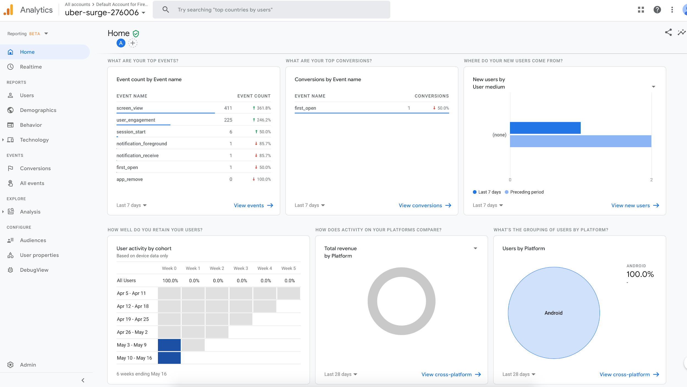

Slide 11
Q&A

Slide 12
THANK YOU

